Slide 1


Code Innovation Series - Kalinga Institute Of Industrial Technology
Online Hackathon
Team Inferno
Topic : HealthTech

Slide 2




Team Inferno Members
Pinaki Bhattacharjee
1906620@kiit.ac.in
2nd year (IT), KIIT
Chandra Prakash
1906548@kiit.ac.in
2nd year (IT), KIIT
Vinayak Singh
1906600@kiit.ac.in
2nd year (IT), KIIT
Manak Sinha
1905602@kiit.ac.in
2nd year (CSE), KIIT

Slide 3






Brief Idea

Slide 4
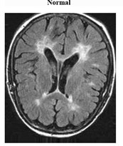

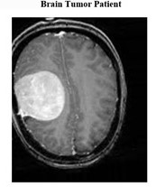
A
B
C

Slide 5









Tech Stack

Slide 6
Unique and Positive Ideas of the Solution
There is no need for Patients to travel to Doctor and can get health reports with just a click.
The website will predict the chances of the disease in the Patient using advanced Machine Learning models.
If the disease is not detected in the patient’s report then there is no need to consult any Doctor or pay any additional fees.
The Patient then can decide whether or not to consult the Doctor and which Doctor to consult.
The Doctor will get notified in the website and also in mail.
The prescription provided by the Doctor can be printed on the Patient’s end.
The health reports uploaded by the Patients will be uploaded into the server in a pool which will in turn help the Machine Learning model to give a more accurate prediction.

Slide 7
Impact on Large Scale
This model can be modified to work well with every other health issues.
Maintaining social distancing is a huge problem and due to the Covid situation around the globe, social distancing is very crucial thing to maintain so this model with eradicate such problems as Patients will be operating from home.
Now Patients can consult Doctors from all around the globe.
Rush in Public Hospitals is an issue of concern, after implementing this model in a wide scale, rush can be controlled to a large extent.
Training Machine Learning models on large scale can also help in research purposes of specific diseases.

Slide 8
THANK YOU

